Slide 1
Python File IO
AI2C Tech Intro

Slide 2
Objectives
Utilize the os and pathlib.Path modules to navigate a filesystem
Utilize standard python functions to manipulate files

Slide 3

Python review

Slide 4
OS module
Python Function | Description
os.getcwd() | Returns the current working directory.
os.chdir(path) | Changes the current working directory.
os.listdir(path='.') | Lists files and directories in the given path.
os.mkdir(path) | Creates a single directory.
os.makedirs(path) | Creates nested directories recursively.
os.remove(path) | Deletes a file.
os.rmdir(path) | Removes a directory (must be empty).
os.rename(src, dst) | Renames or moves a file or directory.
os.stat(path) | Returns info about a file (like size, modified time).

Slide 5
Look familiar?
Python Function | Description | Linux Command Equivalent
os.getcwd() | Get current working directory | pwd
os.chdir(path) | Change current directory | cd path
os.listdir(path='.') | List files and directories | ls
os.mkdir(path) | Create a directory | mkdir path
os.makedirs(path) | Create nested directories | mkdir -p path
os.remove(path) | Delete a file | rm path
os.rmdir(path) | Remove empty directory | rmdir path
os.rename(src, dst) | Rename or move file/directory | mv src dst
os.stat(path) | Get file/directory status | stat path

Slide 6
pathlib
An object-oriented* focused path library
from pathlib import Path
Operation | Example Code
Create / Join Path | Path('folder') / 'file.txt'
Check Existence | p.exists(), p.is_file(), p.is_dir()
Read / Write File | p.read_text(), p.write_text('Hello')
Create Directory | p.mkdir(exist_ok=True)
List Contents | for f in Path('.').iterdir(): print(f)
Search Files | Path('logs').glob('*.txt')
Remove File | p.unlink()
Get File Info | p.stat().st_size, p.stat().st_mtime

Slide 7
Hands-On #1
Navigating file structures with python

Slide 8
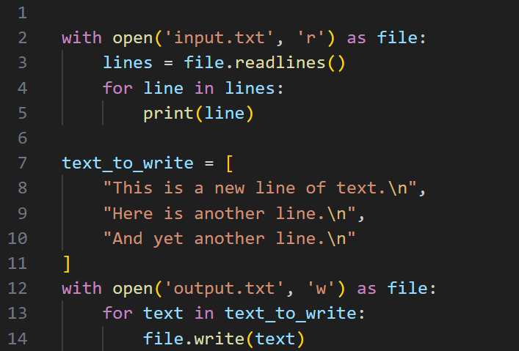
Manipulating files

Slide 9
Common Actions
Operation | Description
with open('file.txt', 'r') as f: pass | Prepare a file for reading
f.read() | Read entire file as a string
f.readlines() | Read file line by line into a list
for line in f: pass | Loop through file line by line
with open('file.txt', 'w') as f: f.write() | Overwrite with new content
with open('file.txt', 'a') as f: pass | Add content to end without erasing existing
f.writelines(lines) | Write a list of strings

Slide 10
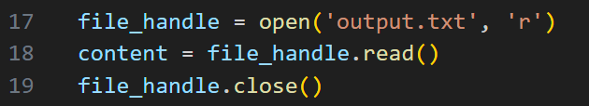
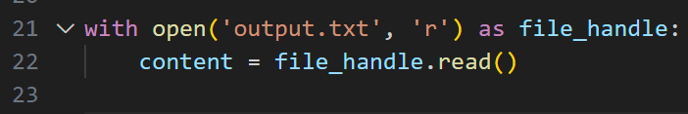
A word about context managers

Slide 11
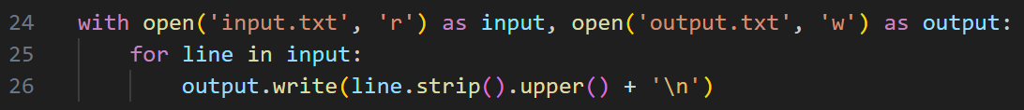
Another word…

Slide 12
Hands-On #2
Manipulate files in python

Slide 13
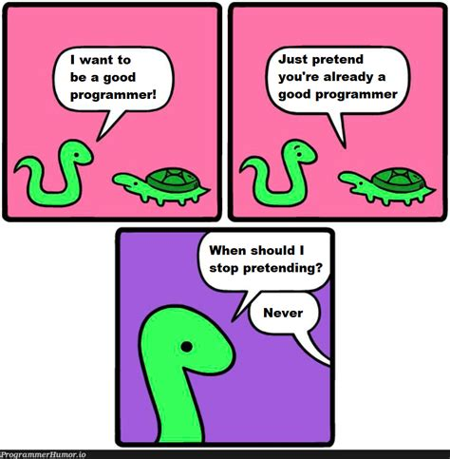
Questions?

